Slide 1
WeNote
Note. Comment. Share.
Team X
liwei Zhu, Fei Guan, Siyuan Yao, Zhiyuan Xu

Slide 2
Implementation
Chrome Plugin
--- Google Extentions Installation
Web Page
--- Static Web Hosting in Amazon S3
Server Program(JAR)
--- Amazon EC2

Slide 3
Functionalities
Chrome Plugin
--- User log-in.
--- Link to the webpage
--- Add notes on the current webpage
--- List the notes from yourself and your friends
--- User Log-out

Slide 4
Functionalities
Webpage
--- User registering
--- User log-in
--- List all notes I write in different webpages
--- Keyword search
--- List all my friends
--- Add friends

Slide 5
In the cloud
AWS S3 bucket: save the static webpages
AWS EC2: deploy the server on an instance
AWS DynamoDB: save the user data and the note data

Slide 6
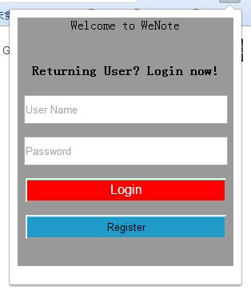
Register

Slide 7
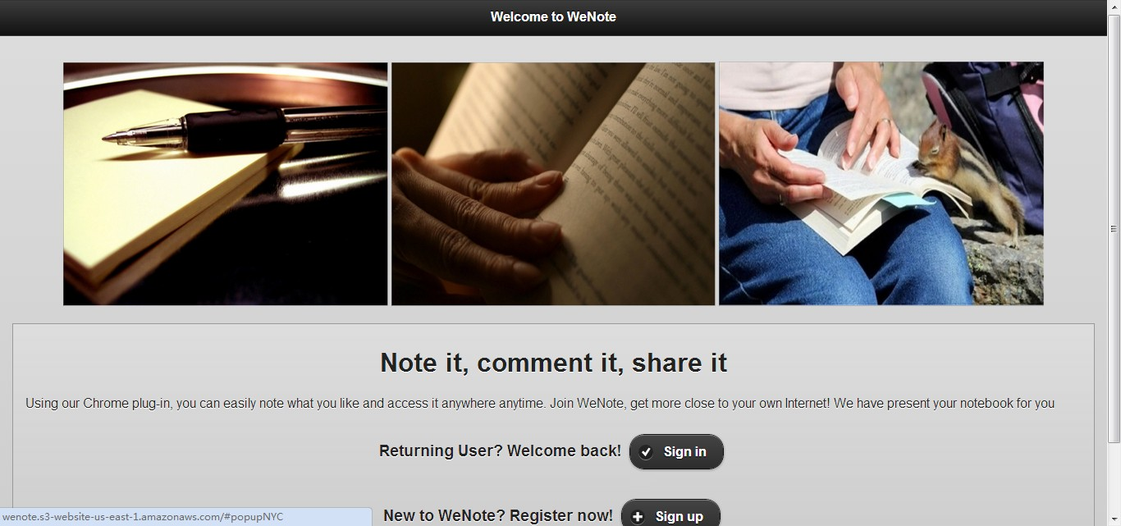
Webpage: Sign in/ Sign up

Slide 8
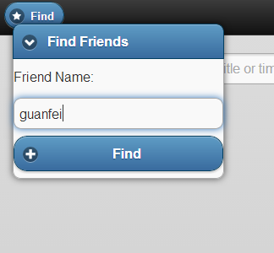
Add Friends

Slide 9
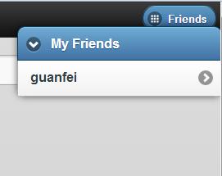
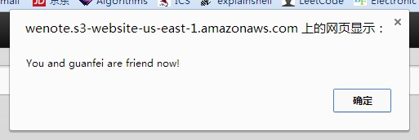
List Friends

Slide 10
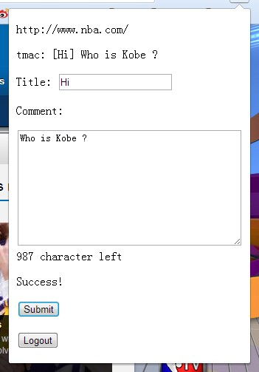
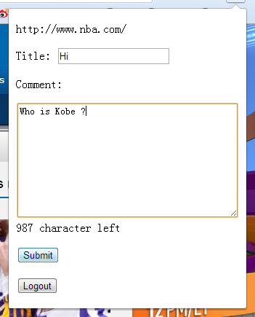
Add Note

Slide 11
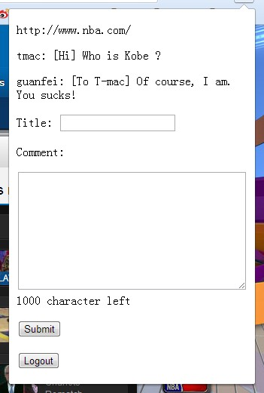
Friends add note

Slide 12
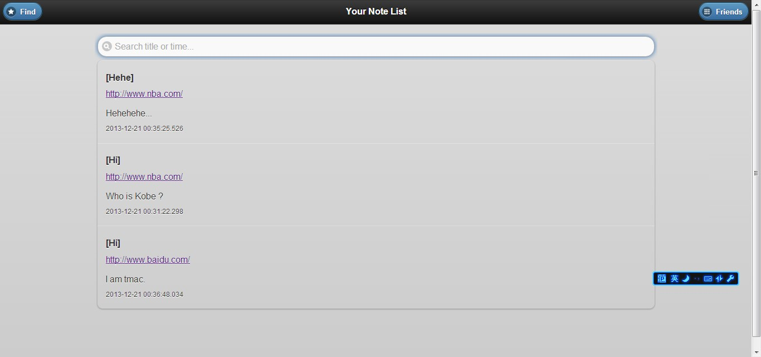
Show Note List on Webpage

Slide 13
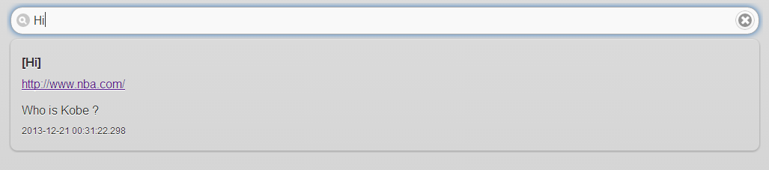
Search note by note name

Slide 14
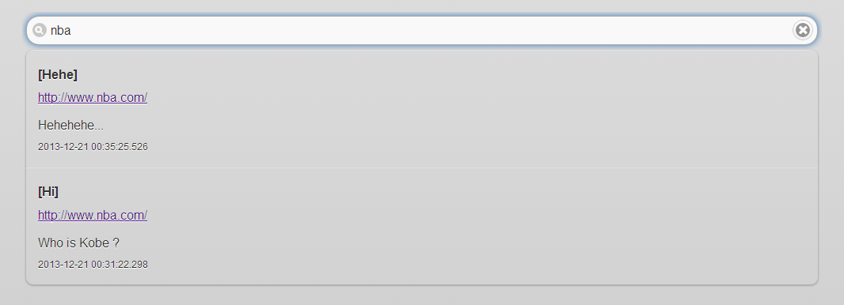
Search note by Website

